Slide 1
AMSC 5710
Advanced Materials Characterization
Ultraviolet photoemission spectroscopy (UPS)

Slide 2

Primary beam
(source)
Secondary beam
(result)
Photons
Electrons
Ions
Phonons
…
Photons
Electrons
Ions
…

Slide 3
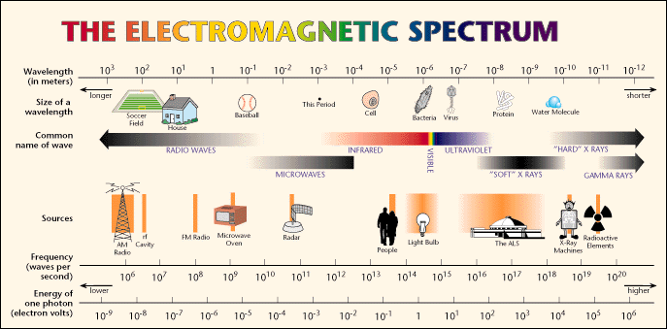
UPS-Ultraviloet light
Ultraviolet light ~ 10⁻⁶ to 10⁻⁸ meter

Slide 4
Content
UPS
Nomenclature
Instrumentation
  UV source
  Synchrotron radiation
Principles
UV Photoemission analysis
  Angle-integrated UPS
  Angle-resolved UPS

Slide 5
UPS-Nomenclature
Nomenclature
X-ray photoelectron spectroscopy, XPS is also known as “Electron Spectroscopy for Chemical Analysis (ESCA).
Actually, it belongs to a family of Photoemission Spectroscopy (PES), in which a photon source is used to excite a sample surface, the energy of those electrons ejected after the photoemission process (photoelectrons) are detected and analyzed. Specifically, if x-ray is used as the photon source, the technique is named as “X-ray Photoelectron Spectroscopy (XPS)”.
If UV source is used instead, the technique is called the “Ultraviolet Photoemission Spectroscopy (UPS) ”.
With the emergence of Synchrotron Radiation, tunable photon source can be generated.

Slide 6
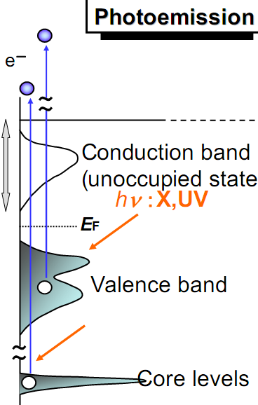
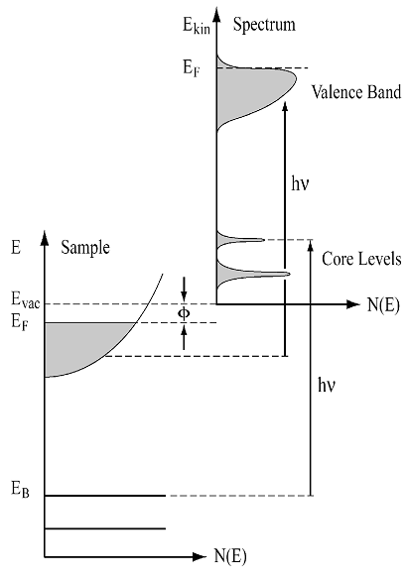
UPS-band structures
Vacuum level

Slide 7
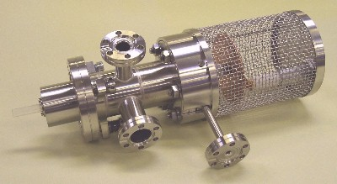
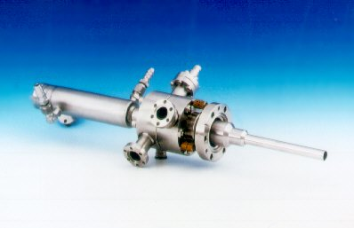
UPS Instrumentation-Photon source
UV source
In UPS, a He discharge lamp is usually used to generate He I (21.2 eV) and He II (40.8 eV) emissions.
Discharge chamber
He gas in
He gas is fed into the discharge chamber;
Upon high tension discharge, He I & II will be formed.
High
tension
Ground
Differential
pumping
UV
Notes:
A most common method to generates characteristic UV emission lines by exciting rare gas atoms via electrical discharge.
Gas Filling: A sealed discharge lamp tube is filled with a high-purity rare gas (e.g., He, Ne, Ar). Helium (He) is the most widely used because its emission lines are sharp, stable, and cover the key energy range for valence electron analysis.
Electrical Discharge Excitation: A high voltage (typically several kilovolts) is applied between two electrodes inside the lamp. This creates an electrical discharge that ionizes the rare gas atoms, promoting their electrons to high-energy excited states.
Photon Emission via Relaxation: When the excited gas atoms relax back to their ground state, they emit photons with discrete energies corresponding to the energy difference between the excited and ground states. These discrete photons form the characteristic UV lines used for UPS.

Slide 8
UPS Instrumentation-Photon source
 | XPS | UPS
Source | Al Kα; Mg Kα | He I; He II
Photon energy | 1486.6eV; 1253.6eV | 21.2eV; 40.8eV
Source line width | 0.85eV; 0.7eV (non-monochromated) | <0.1eV
Peaks | Core level emission; valence band emission; Auger electrons | Valence band emission
Notes:
In Ultraviolet Photoelectron Spectroscopy (UPS), the UV source is designed to generate photons with energy in the range of 10–45 eV — this energy window is ideal for exciting valence electrons (and some shallow core electrons) of materials, while avoiding deep core-level excitation that dominates in XPS.

Slide 9
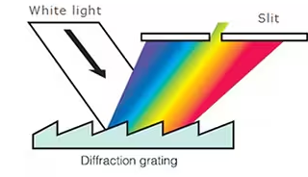
UPS Instrumentation-Photon source
Critical Components for the UV source
Windowless design
No suitable materials that can pass the UV photons.
Floride windows are sometimes used but their cutoff energy is about 10eV, so not suitable for He source at all.
Monochromator
Narrows the line width of the UV beam (to ~0.01–0.05 eV FWHM) is essential for high-resolution valence band structure analysis.
Different grating choice
  Diffraction grating in reflection mode
  Grazing incidence
  Highly reflective material (Pt/Au)
Notes:
For UPS, which operates in the vacuum ultraviolet (VUV) range (He I at 21.2 eV / 58 nm; He II at 40.8 eV / 30 nm), the grating must reflect and disperse these shorter wavelengths efficiently without strong absorption. Platinum-coated gratings are standard because Pt maintains high reflectivity down to ~20–50 nm in VUV, while gold works for somewhat longer wavelengths and aluminum for near-VUV; the substrate (e.g., CaF₂) must also be VUV-compatible to avoid absorption during manufacture or use.

Slide 10
UPS Instrumentation-VUV
VUV condition
VUV refers to ultraviolet light with wavelengths typically from 10–200 nm (energies ~6–124 eV), which requires a vacuum for transmission because most gases, including air and oxygen, strongly absorb it.
But the UV emission is created by ionization of Helium (gas phase)
How to manage non-vacuum and vacuum simultaneously?

Slide 11
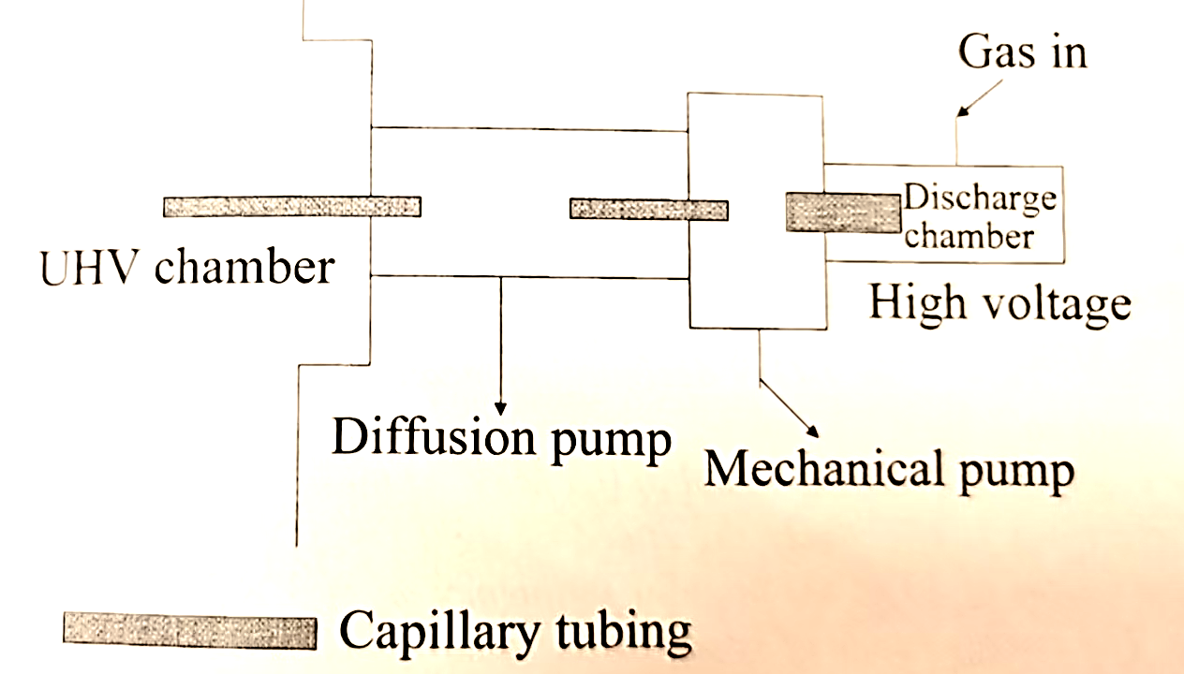
UPS Instrumentation-differential pumping
Considering a capillary tubing of length L and inner diameter D. When a pressure difference dP is established across the length of this tube, the gas flow rate S (in liter- torr/s) is given by dP (torr) x C (liter/s), where C is known as the conductance. Given C as 12D³/L liters/sec. (D and L in centimeters).
For tubing of length 10cm and inner diameter 0.1cm, if the low-pressure end of the tubing is evacuated by a pump speed of 10 liters/s at a pressure of 10⁻⁹ torr, what is the pressure at the other end of the tubing?
The conductance of the tubing is
C = 12D³/L=12 x 0.001/10
= 1.2 1E-3 liters/sec
The gas removal rate is
S=10-9 x 10 =10-8 liter-torr/sec
The pressure differential is
dP=S/C=10-8/1.2 x 10-3
= 0.83 x 10-5 torr
Then the pressure is 0.83 x 10-5 + 10 -9 torr = 0.83 x 10-5 Torr
Notes:
The conductance of the tubing is C = 12 liters/s x 0.001/10 = 1.2 1E-3 liters/sec
The gas removal rate is 10-9 x 10 =10-8 liter-torr/sec
The conductance is 1.2 1E-3 liter/sec
So the pressure differential is 10-8/1.2 x 10-3 = 0.83 x 10-5 torr
Then the pressure is 0.83 x 10-5 + 10 -9 torr = 0.83 x 10-5 Torr

Slide 12
UPS Instrumentation-synchrotron radiation
Synchrotron Radiation
Definition:
Radiation emitted by electrons travelling in a circular orbit at near light speed. Synchrotron radiation occurs in the x-ray and ultraviolet regions of the spectrum. Once considered a dissipative nuisance by accelerator physicists, it can be used to investigate phenomena as diverse as the structures of solids and the interiors of heart vessels
Notes:
Synchrotron radiation facilities provide a superior tunable UV source that surpasses gas discharge lamps in performance.
Electron Acceleration: Synchrotrons accelerate electrons to relativistic speeds (close to the speed of light) in a storage ring.
Synchrotron Radiation Generation: When these high-speed electrons are deflected by magnetic fields (dipole or undulator magnets), they emit broadband, tunable electromagnetic radiation that spans from infrared to hard X-rays.
UV Band Selection: By using monochromators (e.g., grazing-incidence gratings) to select the UV spectral region (10–45 eV), a tunable, high-brightness UV beam is obtained.

Slide 13
Basic principle of synchrotron radiation
Synchrotron radiation is a type of high-intensity, broadband, highly collimated electromagnetic radiation emitted tangentially along the trajectory of relativistic charged particles when they undergo curved motion in a magnetic field.
The generation of synchrotron radiation first requires accelerating charged particles (usually electrons or positrons) to relativistic speeds (close to the speed of light, GeV)
Dipole magnets generate a uniform bending magnetic field whose direction is perpendicular to the charged particle motion direction (subjected to the Lorentz force F=qv×B) . The particles to move in a uniform circular motion along a circular orbit, with a centripetal acceleration that is the direct cause of synchrotron radiation generation.
vs. Bremsstrahlung

Slide 14
Features of synchrotron radiation
Highly collimated radiation
  The axis of the cone coinciding with the tangential direction of the particle motion.
  The cone angle θ is inversely proportional to the relativistic factor γ, so that the radiation cone angle is only on the order of milliradians.
  The collimation of the radiation beam is comparable to that of a laser.
Continuous spectrum
  Covering a wide wavelength range from far-infrared, visible light, and ultraviolet to soft X-rays and hard X-rays, with extremely high photon flux.
  Energy range E~ℏω₀γ³ , where γ=(1-v²/c²) ^{-1/2} is the ratio of electron mass to its rest mass, and ω₀ is the orbital angular frequency.
Linearly polarized within the orbital plane and elliptically polarized outside the plane.

Slide 15
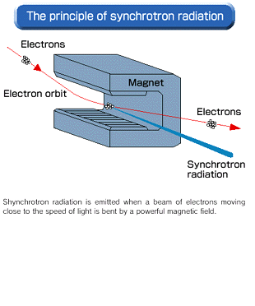
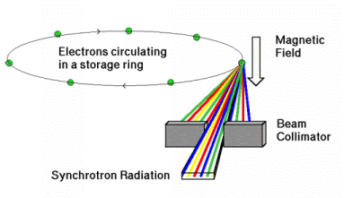
Synchrotron radiation-instrumentation
Synchrotron Radiation
Synchrotron radiation characteristically is highly polarized and continuous. Its intensity and frequency are directly related to the strength of the magnetic field and the energy of the charged particles affected by the field. Accordingly, the stronger the magnetic field and the higher the energy of the particles, the greater the intensity and frequency of the emitted radiation. Synchrotron radiation is thus often termed nonthermal radiation.
Supplementary reading:
Classical theory of synchrotron radiation
Characteristics of synchrotron radiation

Slide 16

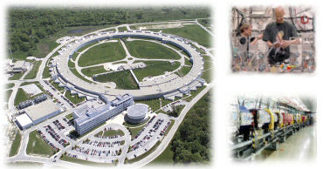
Synchrotron radiation-instrumentation
Synchrotron Radiation
A synchrotron radiation facility is composed of an injector and a storage ring. The injector generates an electron beam and accelerates electrons to high energies. The storage ring has a shape of a ring and accumulates the accelerated electrons in it.
European Synchrotron Research Facility (ESRF) in Grenoble, France
Advanced Photon Source
(APS) Argonne, USA
Notes:
Key Historical Synchrotron Facilities:
First Observation (1947): General Electric (GE) Research Laboratory (Schenectady, NY).
First Characterization (1947/48): Cornell University (using a 300 MeV synchrotron).
First Generation (Parasitic): SURF (USA), Frascati (Italy), and DESY (Germany) used synchrotrons built for particle physics to produce light.
Second Generation (Dedicated): The Synchrotron Radiation Source (SRS) at Daresbury in the UK was the first specifically designed for synchrotron light, starting operation in the early 1980s.
Third Generation: The European Synchrotron Radiation Facility (ESRF) (France) was the first dedicated, high-energy third-generation source (1994).

Slide 17
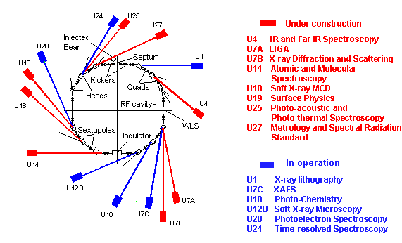
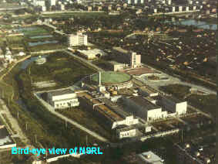
Synchrotron radiation-instrumentation
First Synchrotron Radiation in China
The National Synchrotron Radiation Laboratory (NSRL) is the first dedicated synchrotron radiation facility in China, which locates at the west campus of the University of Science and Technology of China (USTC), in Hefei city, Anhui Province.
A new one has been operational in Shanghai since 2009

Slide 18
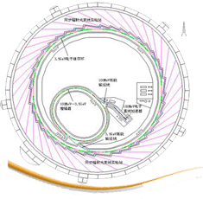

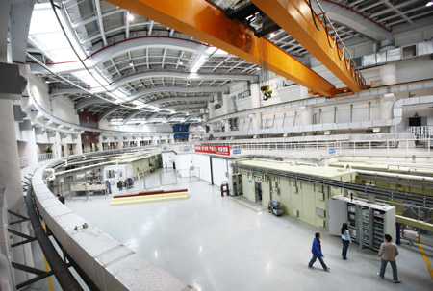
Shanghai Synchrotron Radiation Facility (SSRF)
Energy | 3.5GeV
Circumference | 432m
Lattice | DBA
Number of Cells | 20
Straight Sections | 4×12m, 16×6.50m
Current | 200~300mA
Emittance | 3.9 nm-rad
Life time | > 10hrs (Top-up injection available later)
Beam position stability | ±10% (< ± 3mm)

Slide 19
UPS Principles
Ultraviolet photoemission spectroscopy (UPS) is very similar to XPS. However, instead of an x-ray source, a UV source is used to excite the sample.
Upon UV excitation, photoemission proceeds, leading to ejection of photoelectrons as in XPS.
The UV photons have an energy of about several tens eV, which is not enough to photo-ionize core level electrons.
Electrons of more loosely bound states (e.g. VB in semiconductors; HOMO in organic substances) could be photo-emitted upon UV illumination.
These photoelectrons can reveal details about the electronic band structure (energy level and crystal momentum) of the sample under study.

Slide 20
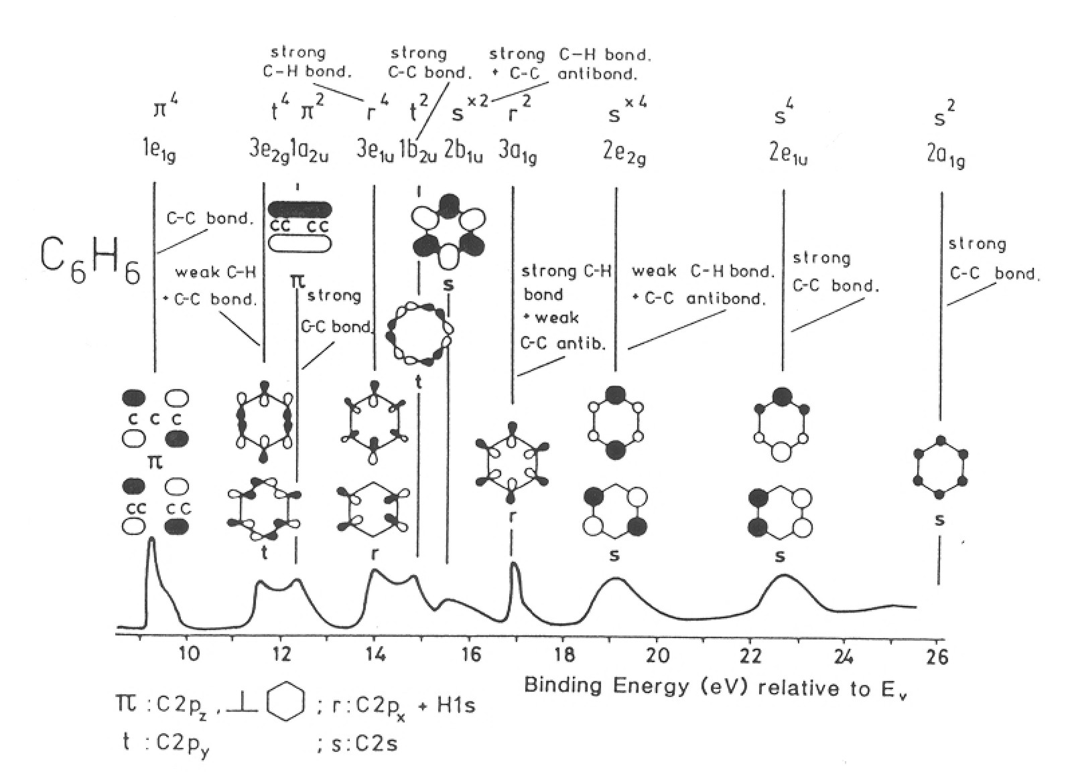
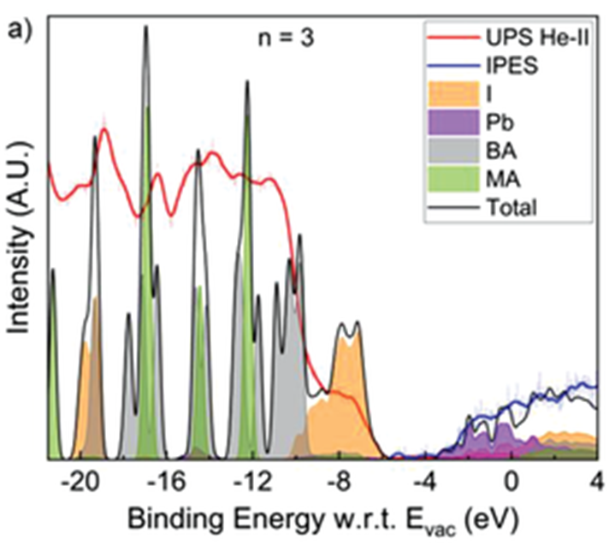
UPS Principles
In high resolution UPS analysis, the valence band structure of a compound, a molecule or a crystal structure can be revealed;
the UPS peaks can be assigned to different valence energy levels;
the UPS peaks can be regarded as the fingerprint for a specific compound, molecule or crystal structure;
also, UPS peaks may be used to construct the valence band energy diagram;
usually, the UPS spectra will be compared with theoretical energy levels calculated through computation.
Ruddlesden–Popper Perovskites

Slide 21
UV Photoemission Analysis
Angle-integrated UPS
in angle-integrated UPS, a large cone of photoelectrons are collected
i.e. photoelectrons originated from different k values are collected
as a result, the angular effect is averaged out
detailed band structures are hidden
Angle-resolved UPS
in angle-resolved UPS, a very small cone of photoelectrons is collected, i.e. photoelectrons originated from different k values can be collected separately by varying the detection angle
detailed band structures can thus be revealed

Slide 22
Angle integrated UPS
Taking a semiconductor as an example

Slide 23
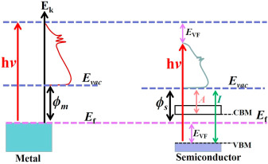
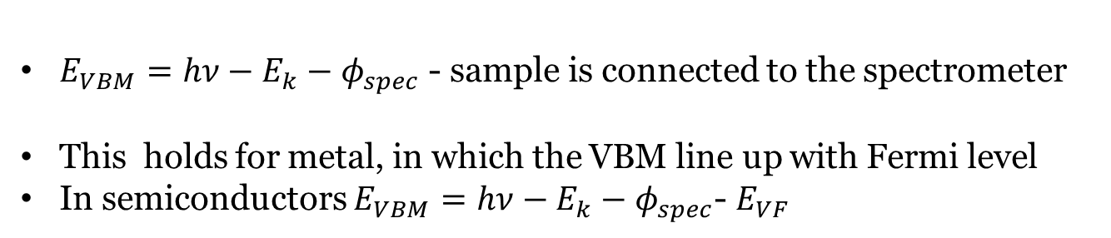
Angle integrated UPS
$E_{VBM}=hν−E_{k}−φ_{spec}$ - sample is connected to the spectrometer
This holds for metal, in which the VBM line up with Fermi level
In semiconductors $E_{VBM}=hν−E_{k}−φ_{spec}$- $E_{VF}$

Slide 24
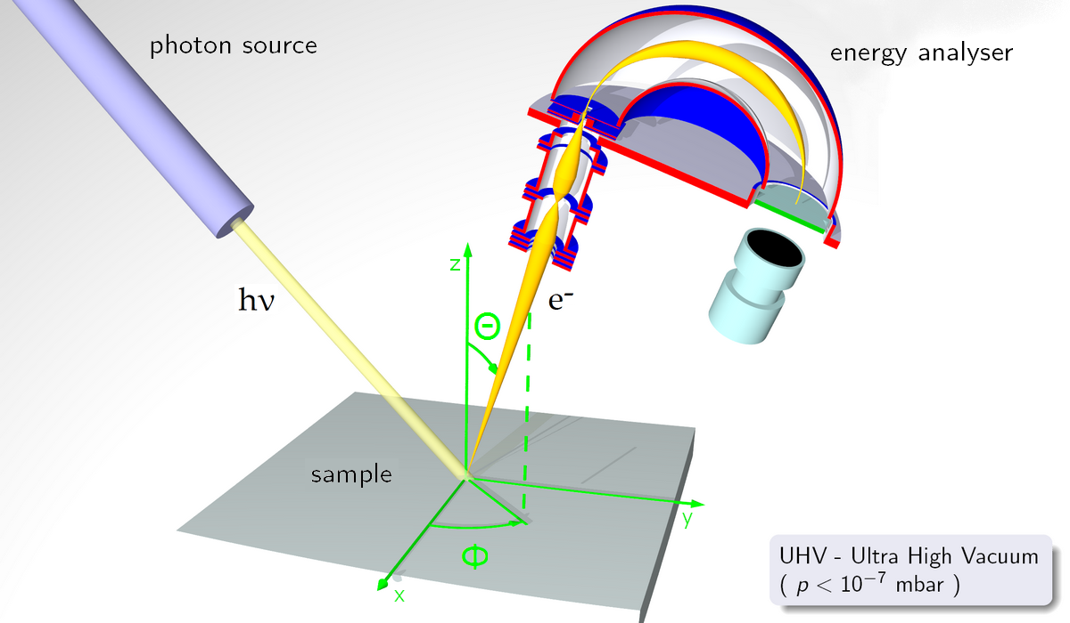
Angle resolved UPS (ARUPS)
ARUPS is commonly known as Angle-Resolved Photoemission Spectroscopy (ARPES)
When UV photoelectrons are collected at different angles, the resultant UPS spectrum will reflect the specific band structure at a certain k value corresponding to the specific angle of collection.
It is one of the most direct methods of studying the electronic structure of solid surface

Slide 25
The key of ARPES is to establish a quantitative connection between the emission angle of photoelectrons and the in-plane momentum of electrons inside the sample, thereby deriving the intrinsic electronic structure of the material..
E_{k}
kinetic energy of the outgoing electron
hk_{vacuum}
momentum of the outgoing electron
Measured
Vertical momentum component (p⊥​): Perpendicular to the sample surface, its magnitude is related to the binding energy of electrons and the surface barrier (work function).
In-plane momentum component (p∣∣​): Parallel to the sample surface, it is the key physical quantity for ARPES to characterize the electronic structure.

Slide 26





$$p_{vacuum, ∥}=ℏk_{vacuum,∥}=\sqrt{2mE_{k,∥}}$$
$=\sqrt{2mE_{k}}\sin{θ}$
Measurement of the dispersion curve requires a determination of the initial wave vector of the emitted photoelectrons.
Three-step model:
1) The electron is excited from an initial to a final state within the crystal;
2) The electron travels through the solid towards the surface;
3) The electron crosses the surface and is emitted into the vacuum with a certain kinetic energy.
$$k_{initial,∥}$$
$$k_{sample,∥}$$
$$k_{vacuum,∥}$$

Slide 27

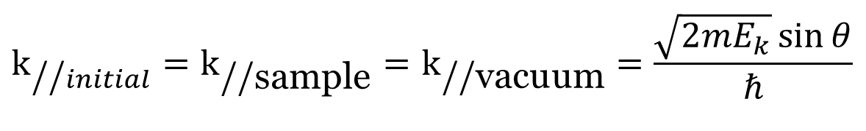
Momentum conservation
Photon momentum is neglected because of its smallness compared with electron momentum. Therefore, electron momentum is conserved after the photon-electron interaction.
Electron momentum:
X
Photon momentum:
X
$$k_{\text{//}initial}=k_{\text{//sample}}=k_{\text{//vacuum}}=\frac{\sqrt{2mE_{k}}\sin{θ}}{ℏ}$$
The in-plane momentum of the photoelectron escaping from the sample surface is equal to the in-plane momentum of the electron in the sample before excitation
Intensity profile N (E_{k}, θ) measured
—DOS dispersion as a function of $k_{\text{//}initial}$
Notes:
The momentum brought by the incident ultraviolet photons can be completely ignored in the photoelectric process.

Slide 28

To determine
To determine $k_{⊥sample}$*
The surface represents a scattering potential with only 2D translational symmetry.
m* is the effective mass of the electron and with inner potential V₀, there is:

Slide 29
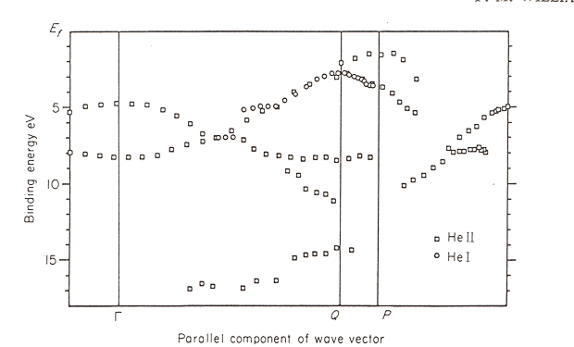
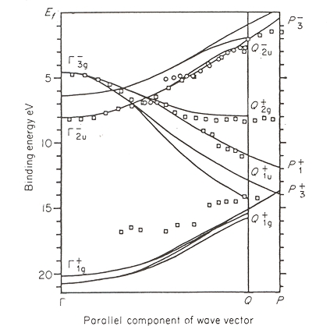
Angle resolved UPS*
in ARUPS, UPS spectra are collected as various acceptance angle, θ, the position and relative intensity of the UPS peaks are carefully traced and recorded.
if enough accurate data are acquired, a band structure diagram can be constructed, giving us more detailed information on the valence band structure of the sample.

Slide 30
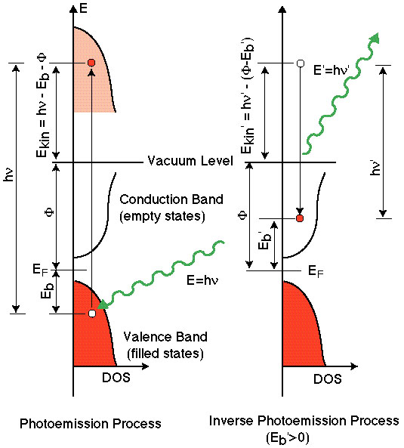
Inverse photoemission (IPES)
UPS give information about occupied states
IPES gives information about unoccupied states.
e-
hν
hν
e-

Slide 31
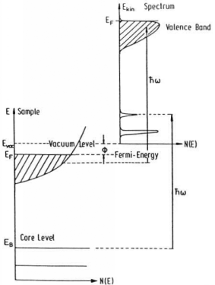
Why XPS not good for study of bands?
XPS indeed can excite valence bands to get information about such as density of states, however, it is not suitable for the study of valence bands, especially for the study of energy dispersion (k dependence).
XPS photon energy is too high, the transition probability for valence bands is very small compared with UV light.
XPS photon have too large energy which leads the electrons from valence bands with very high E_{kin}. It is hard to analyze spectra with high kinetic energy with high resolution.

